Slide 1

ReBookify
100008_IT622T MINI PROJECT – GROUP 16 S6 AD

Slide 2

INTRODUCTION
Books are a valuable source of knowledge and education, but not everyone can afford to buy new books.
Buying second-hand books online is a solution that saves time, money, and energy.
The project is an E-Commerce website that provides second-hand books to students at affordable rates

Slide 3

Problem Statement/Objective
Facilitating the buying and selling of second-hand engineering books within a specific college community through a web application.

Slide 4
Applications/Relevance
Connects senior students selling their old books with junior students in need.
Enhances affordability by promoting second-hand book transactions.
Provides a sustainable solution for reusing educational resources.
Enables pass-out students to sell books or donate them to the college library.

Slide 5
Challenges in Developing REBOOKIFY
Inventory Management
User Experience
Legal Considerations

Slide 6
Existing/Related Works
College Bookstore
Online Marketplaces
Social Media Groups.
College Libraries

Slide 7
Modules
User Interface (UI)
User Management Module
Book Listing Module
Book Searching and Browsing Module
Book and User Authentication
Pass-Out Student Module
Database

Slide 8
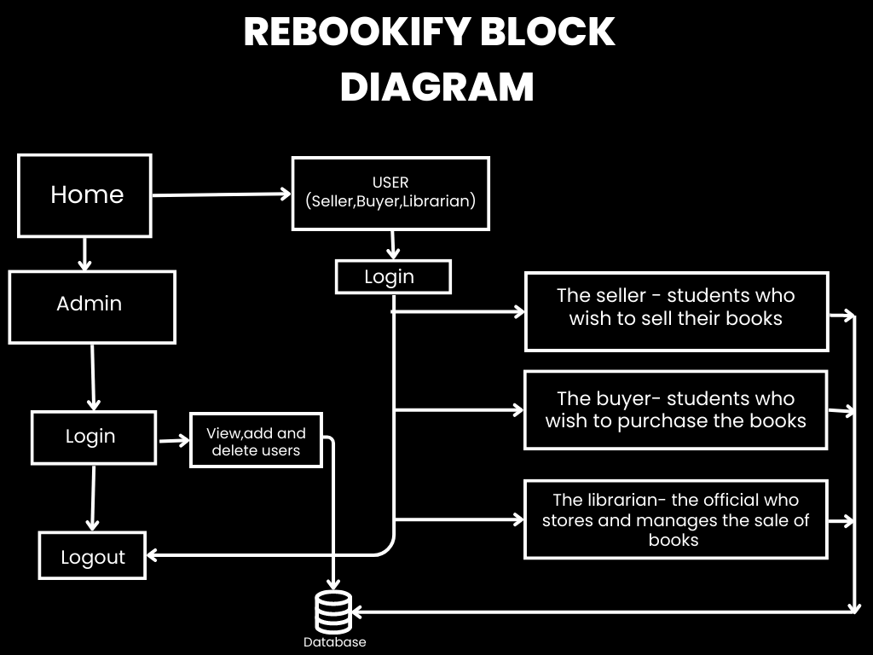

Slide 9

Data Flow Diagram

Slide 10
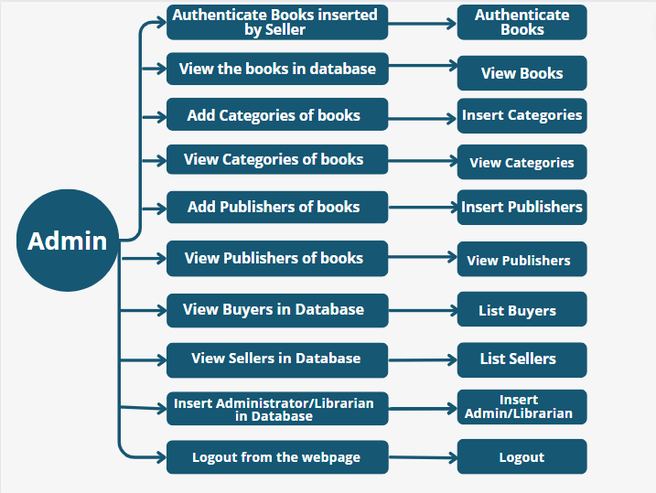

Slide 11
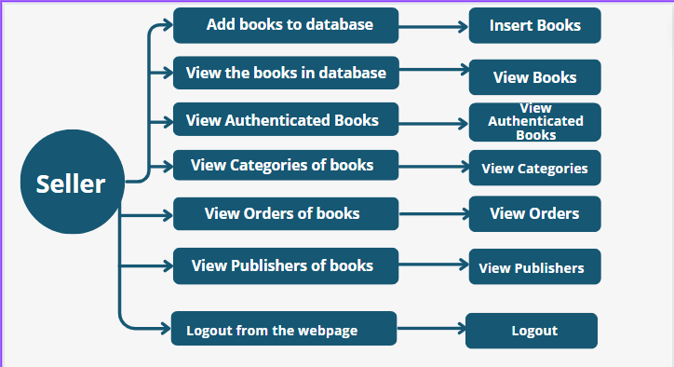

Slide 12
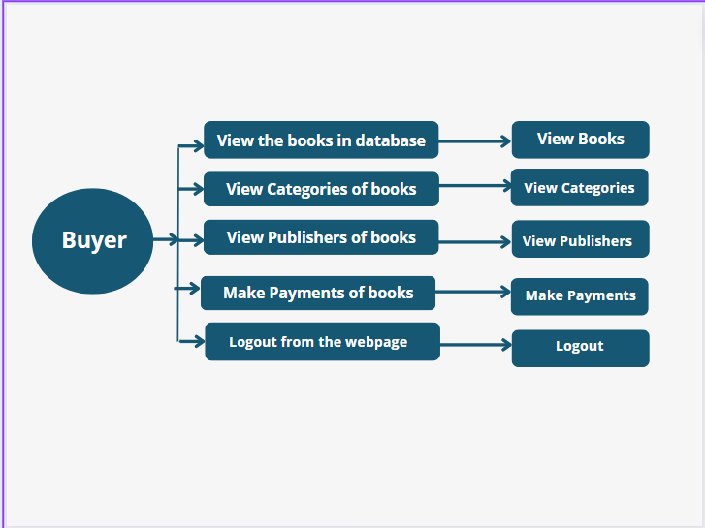

Slide 13
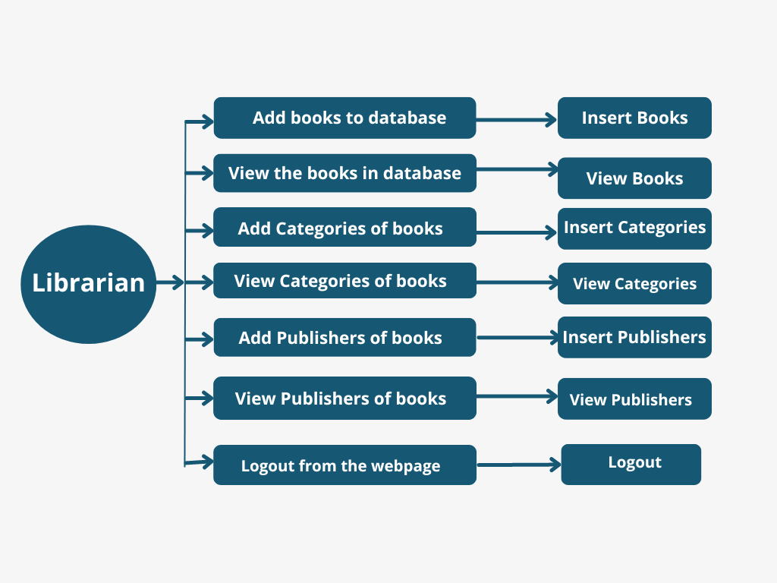

Slide 14

Database Design

Slide 15
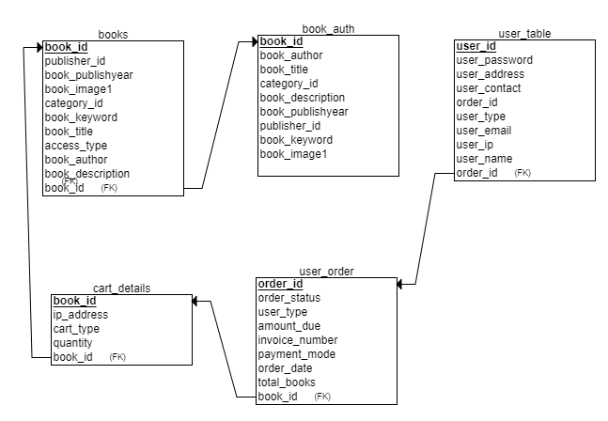

Slide 16

ER Diagram

Slide 17
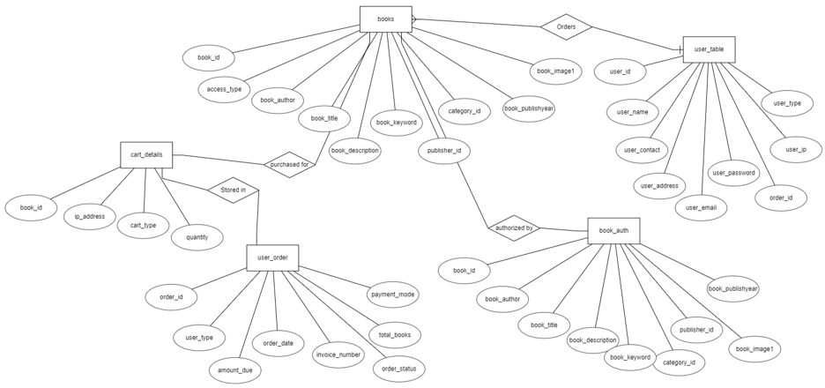

Slide 18
Implementation Details
IDE (Visual Studio Code Editor)
Database : MySQL
HTML
PHP
JavaScript
CSS
Host Server: XAMPP

Slide 19
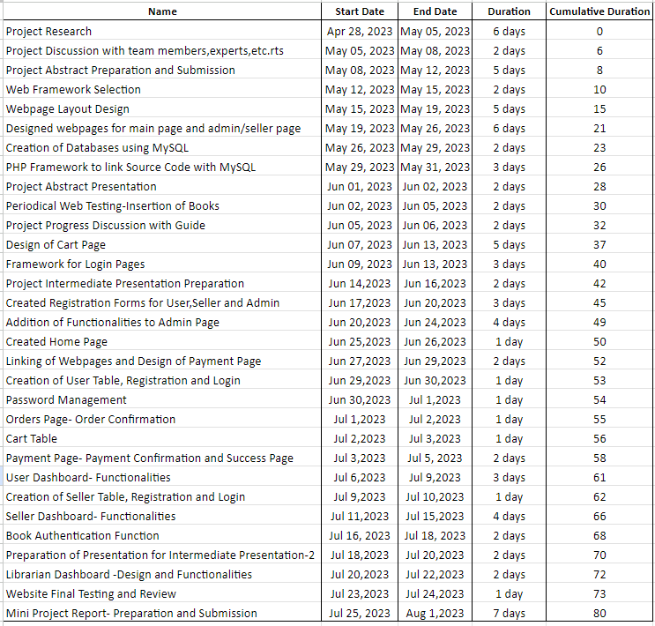
Project Schedule

Slide 20
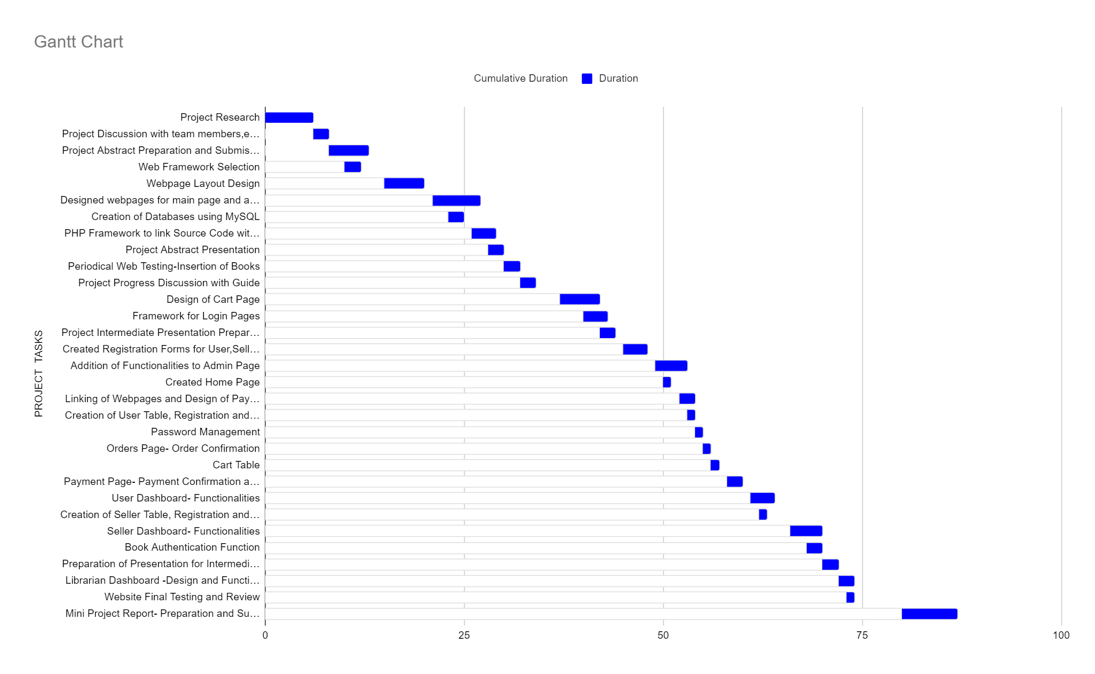

Slide 21
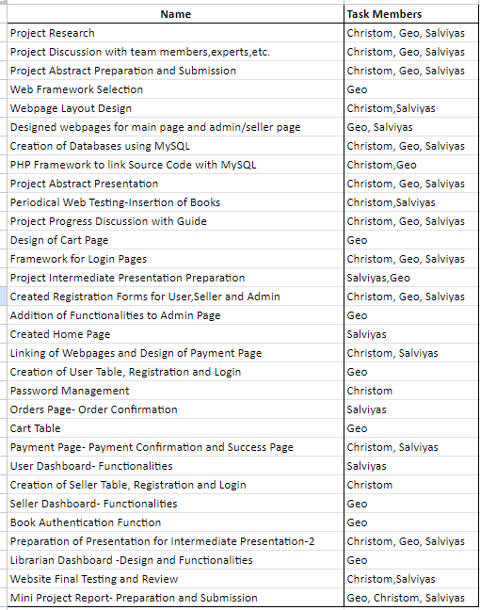
Task Assignment

Slide 22

SCREENSHOT OF WORK DONE

Slide 23
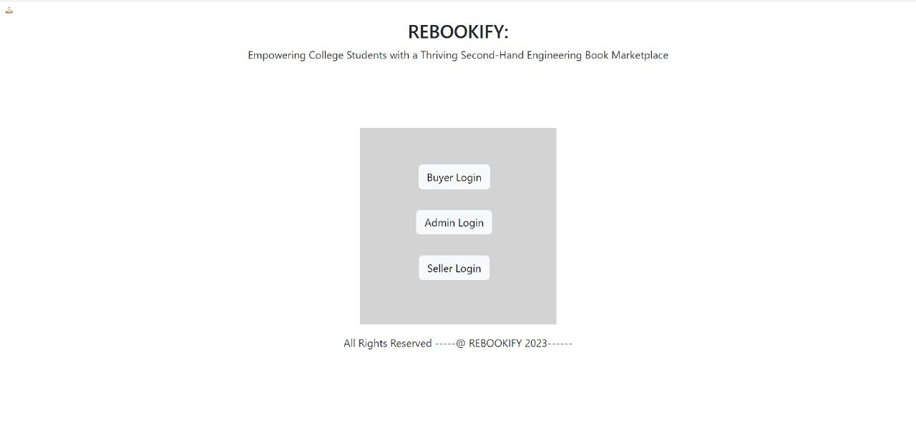

Slide 24
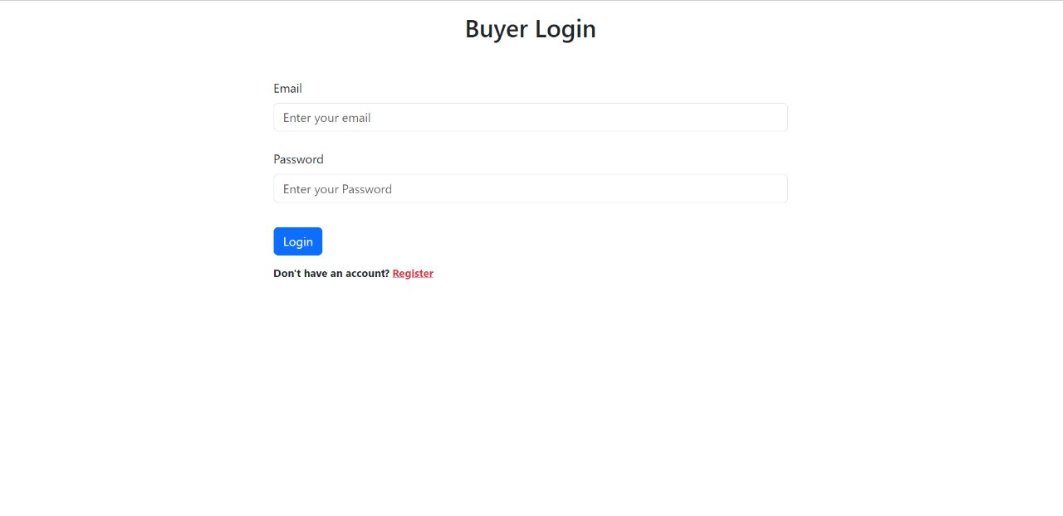

Slide 25
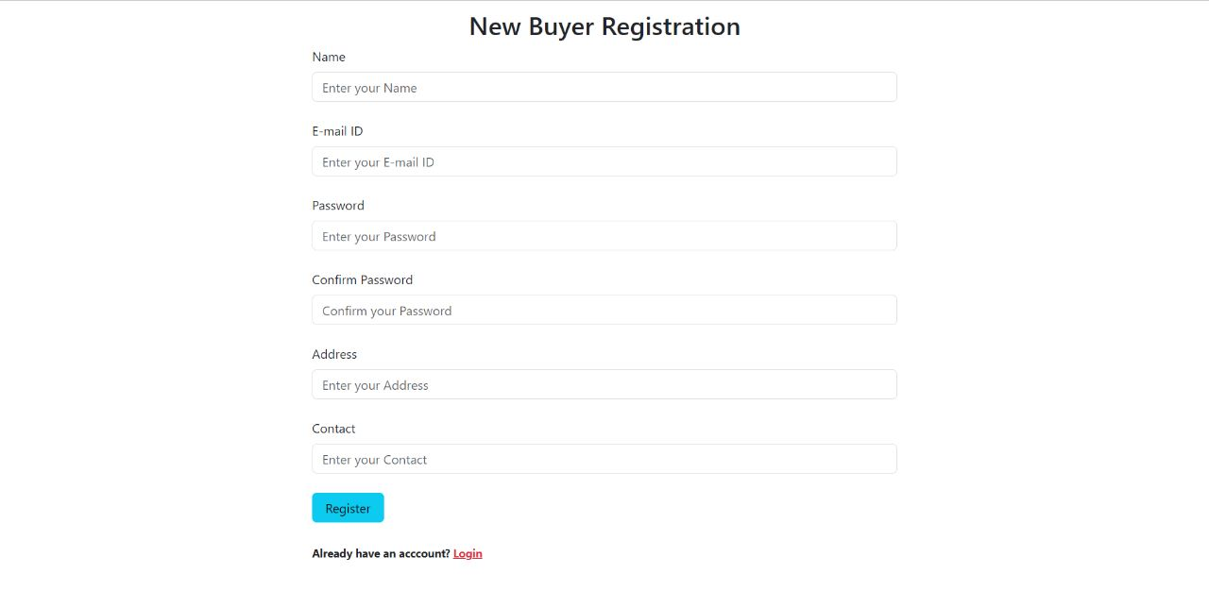

Slide 26
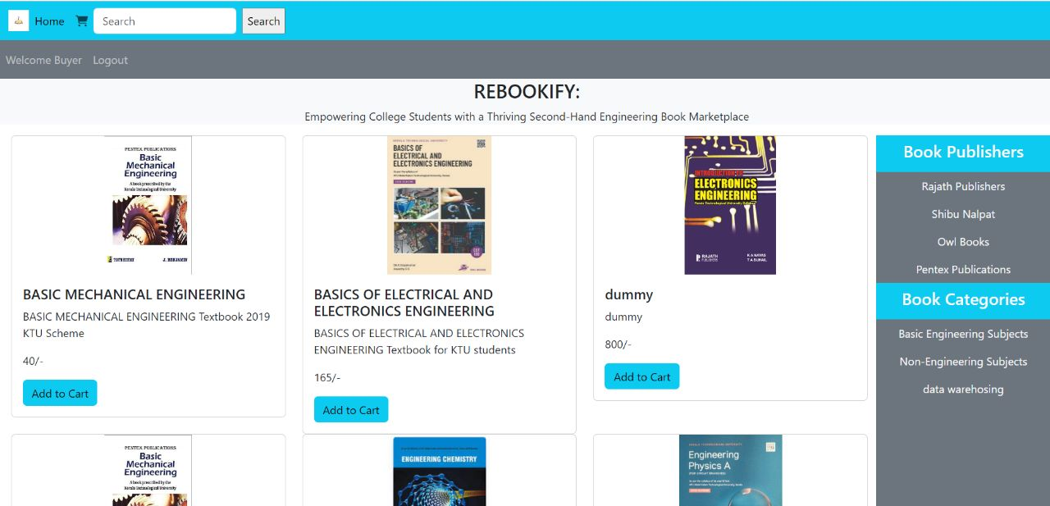

Slide 27
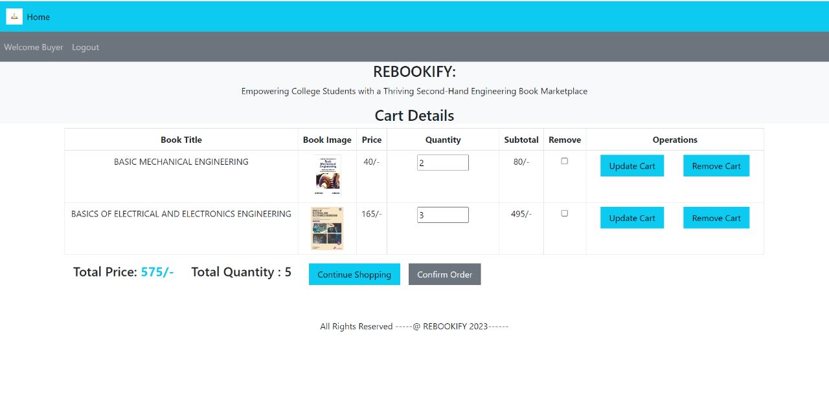

Slide 28
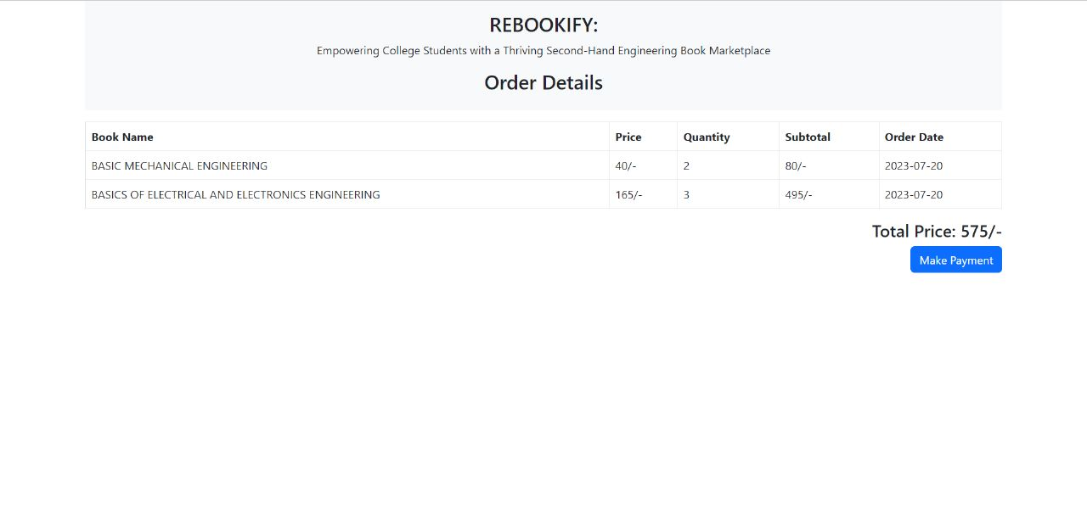

Slide 29
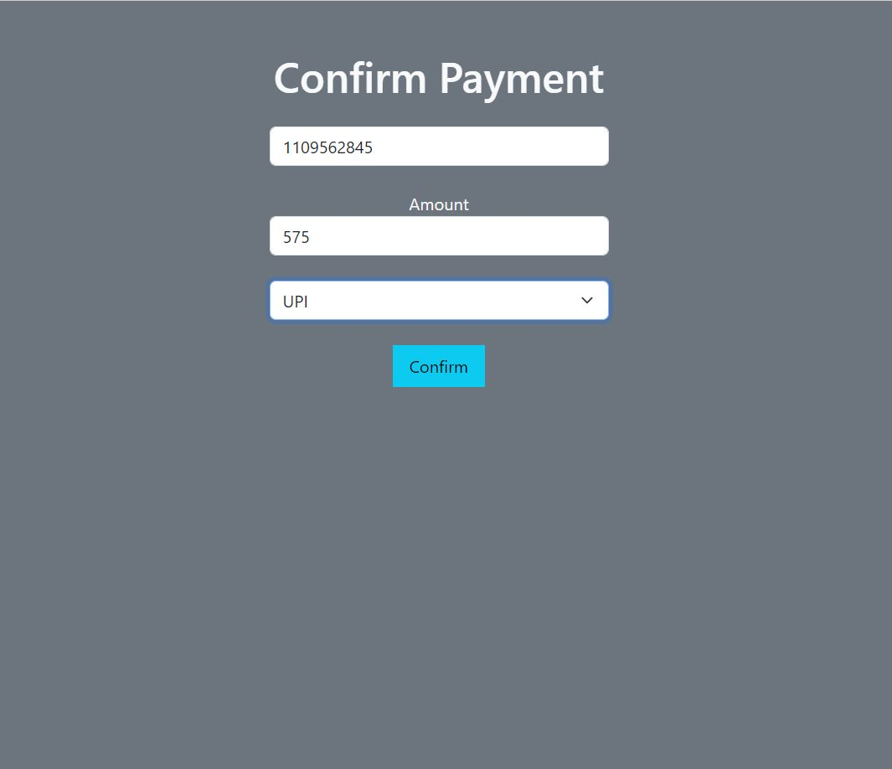

Slide 30
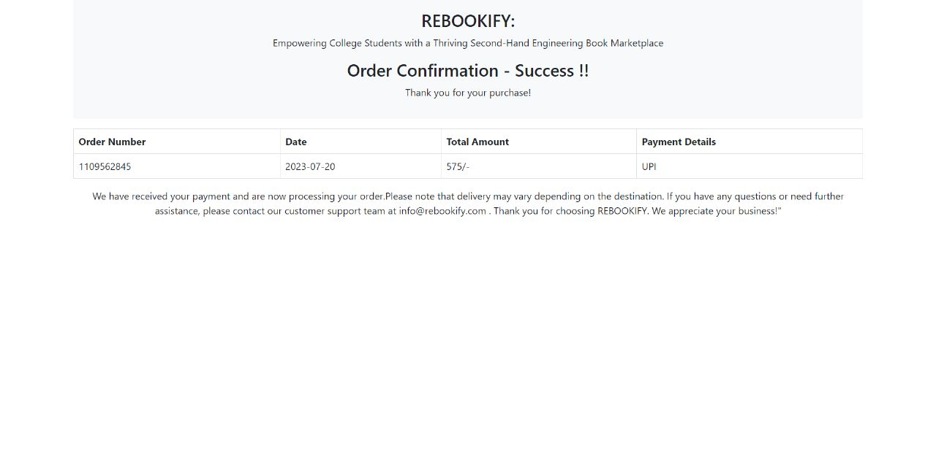

Slide 31
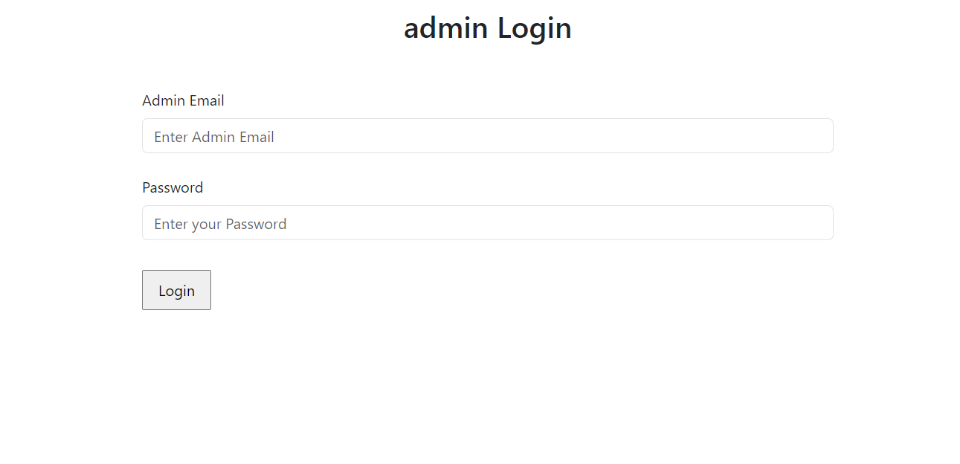

Slide 32
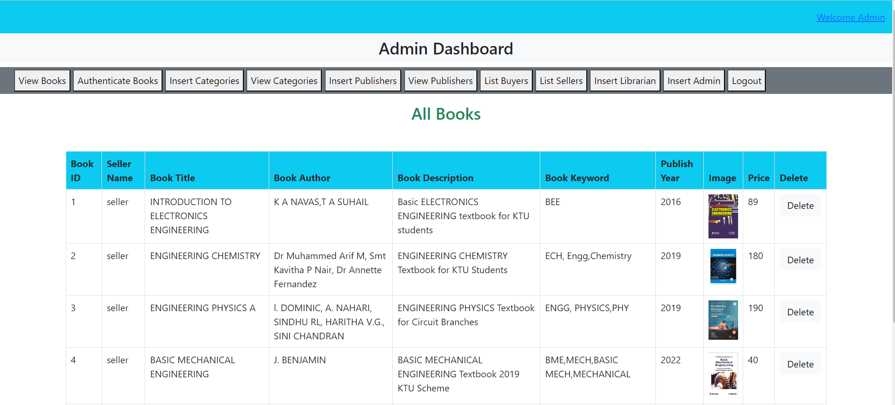

Slide 33
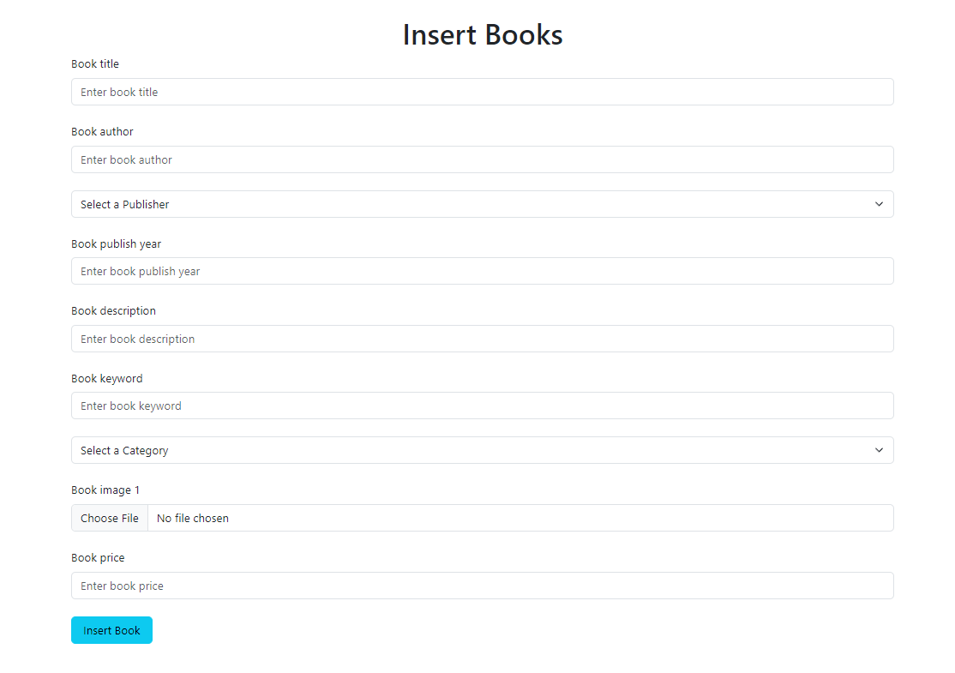

Slide 34
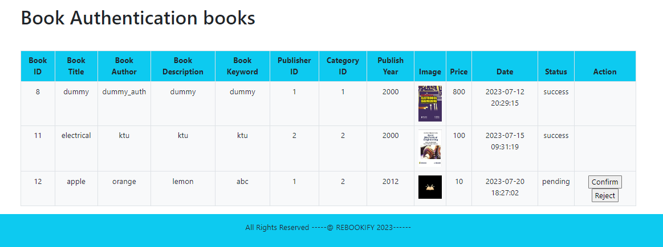

Slide 35
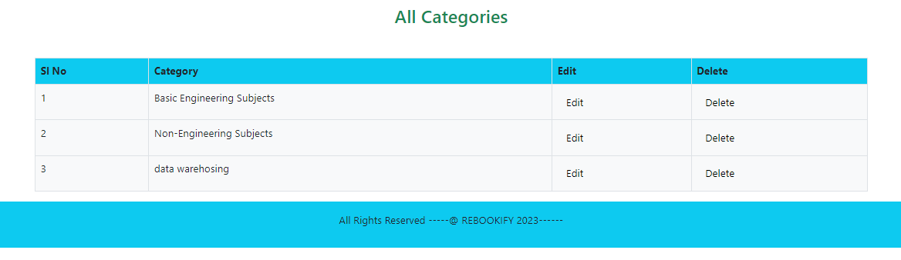
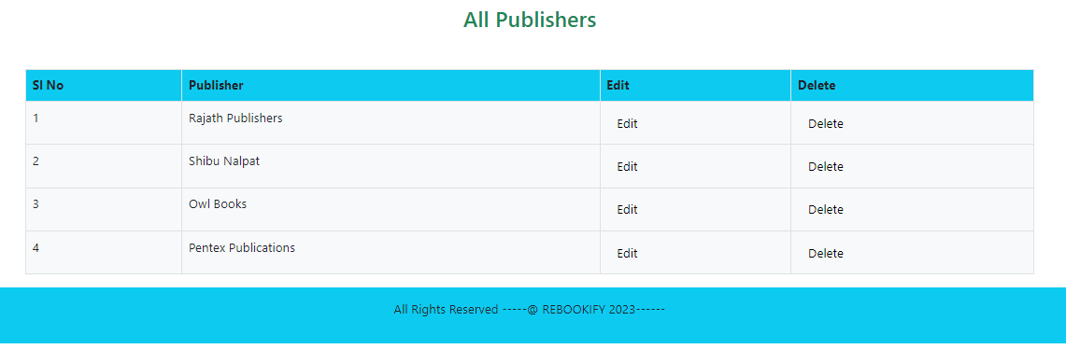

Slide 36
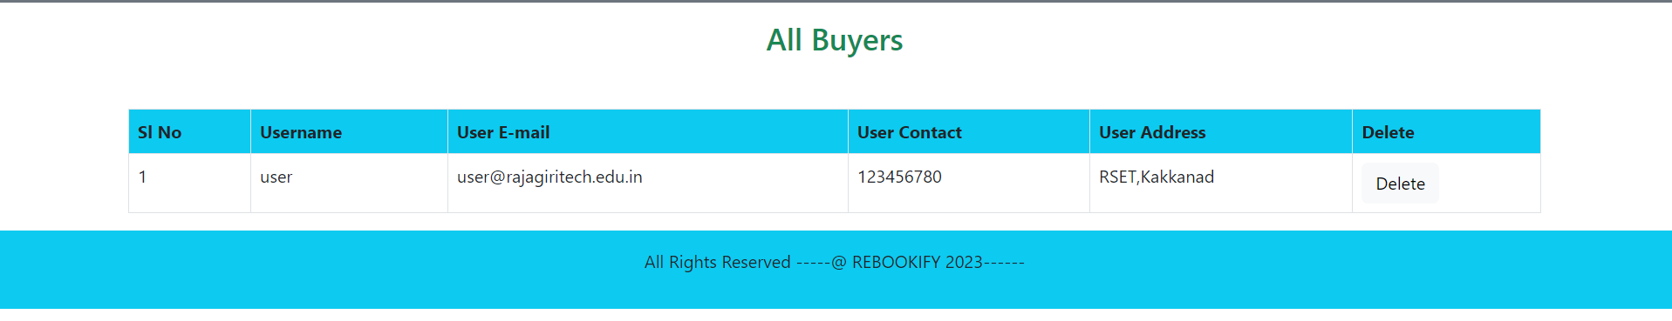
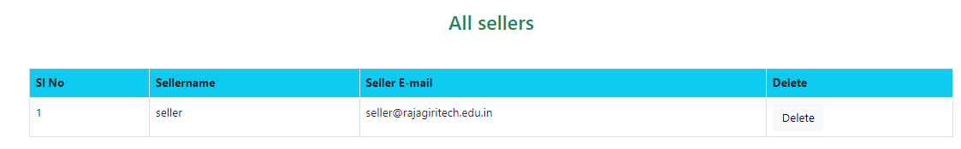

Slide 37
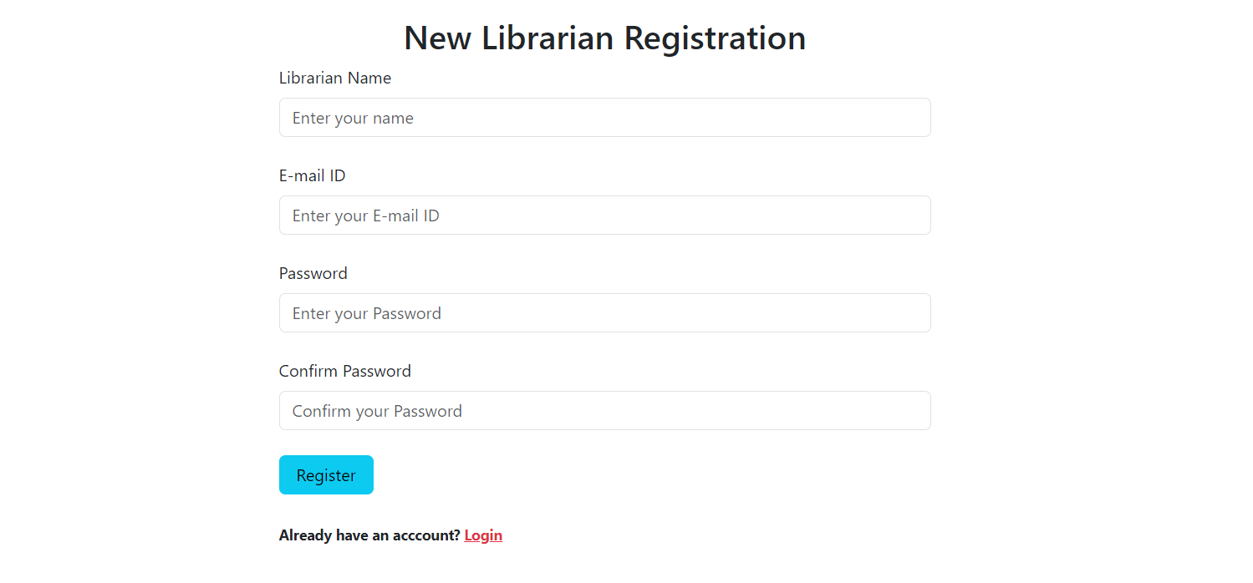

Slide 38
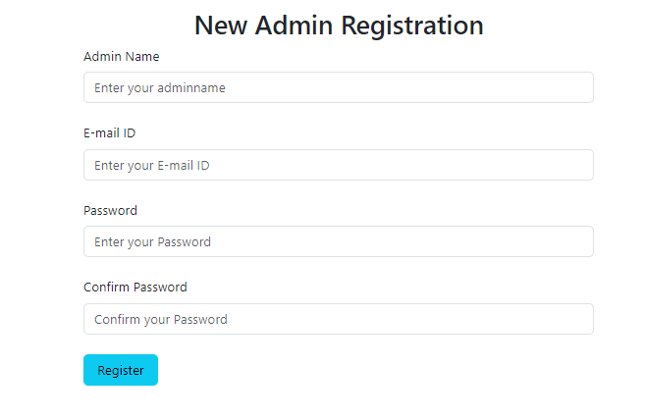

Slide 39
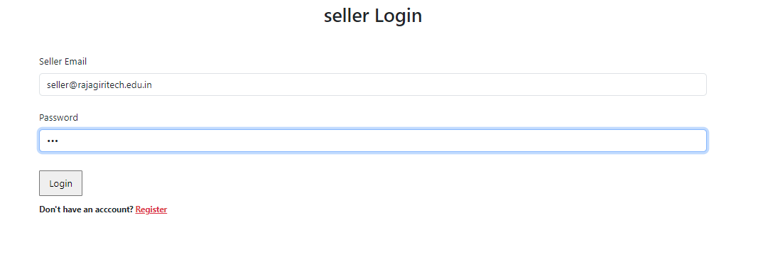

Slide 40
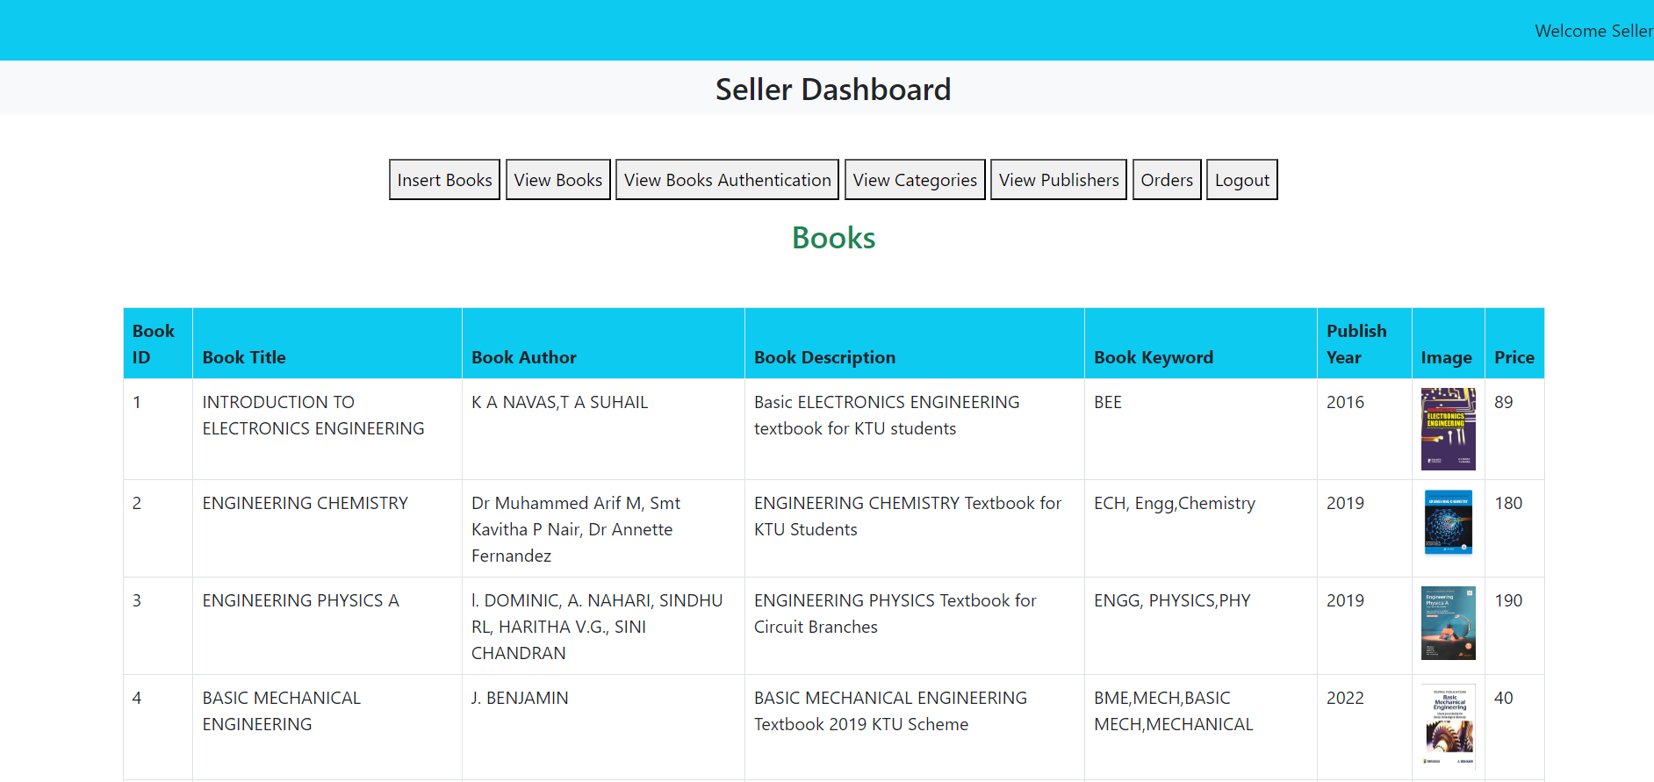

Slide 41
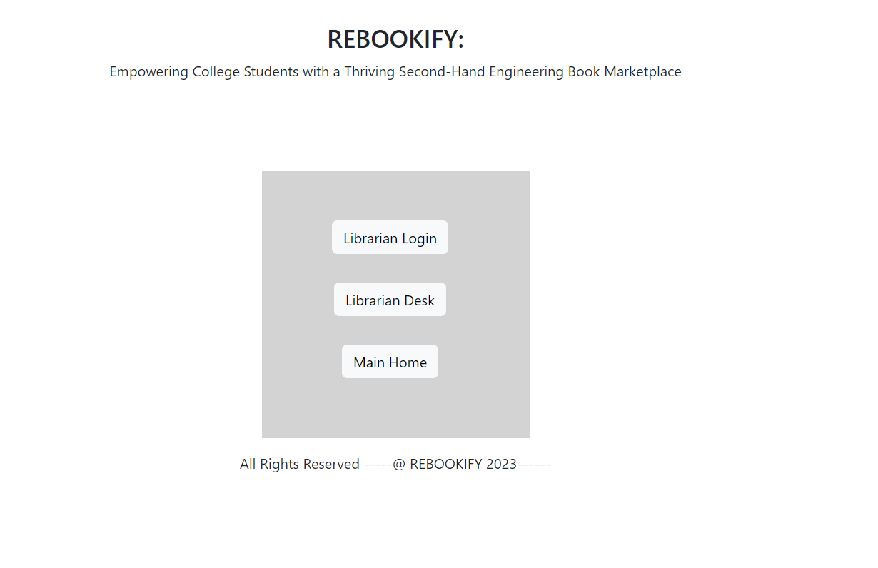

Slide 42
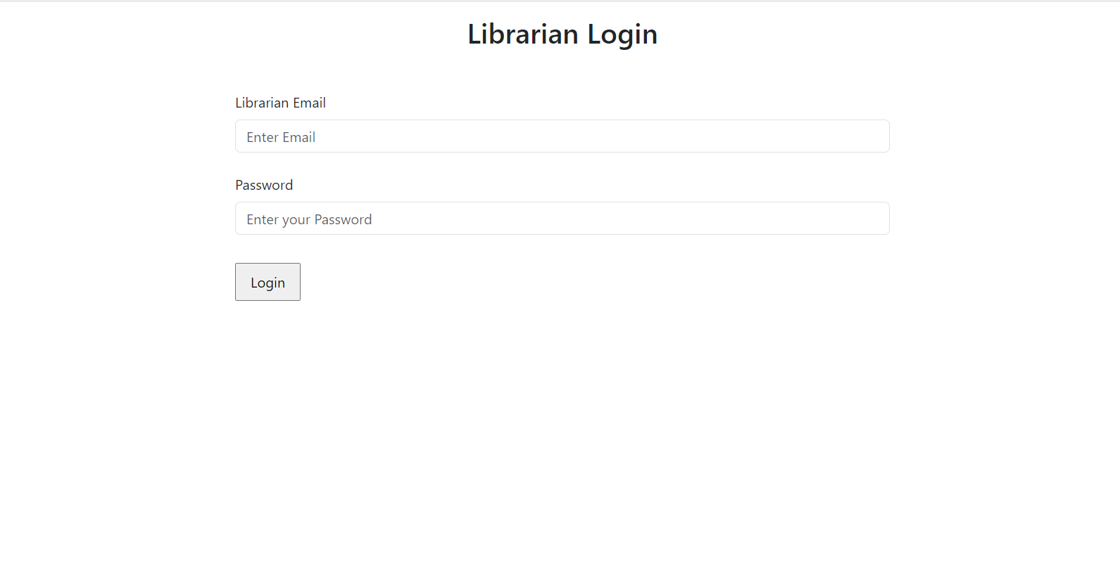

Slide 43
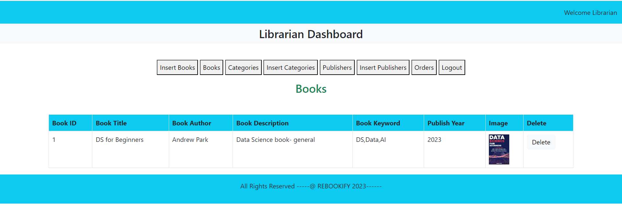

Slide 44
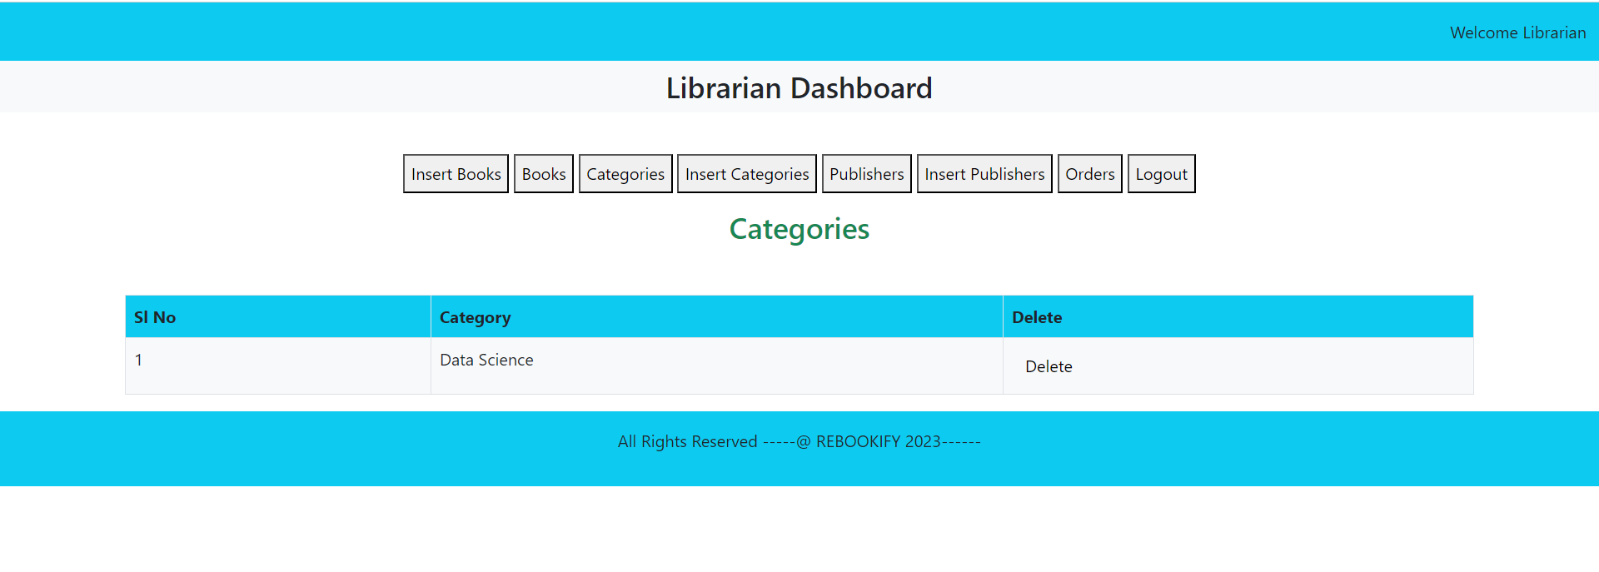

Slide 45
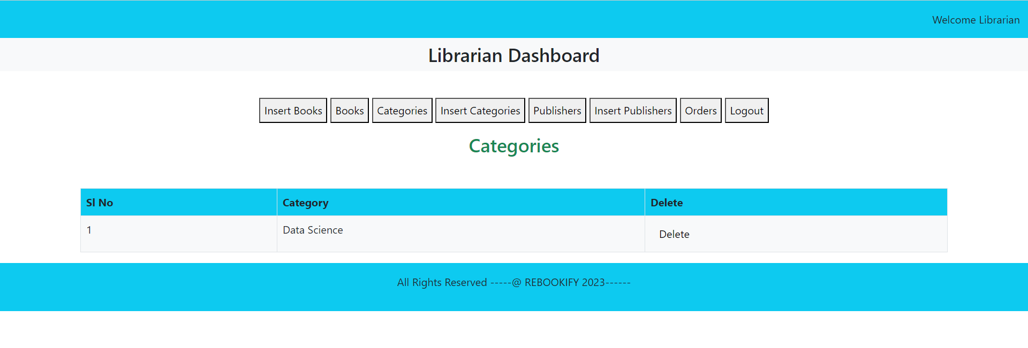

Slide 46
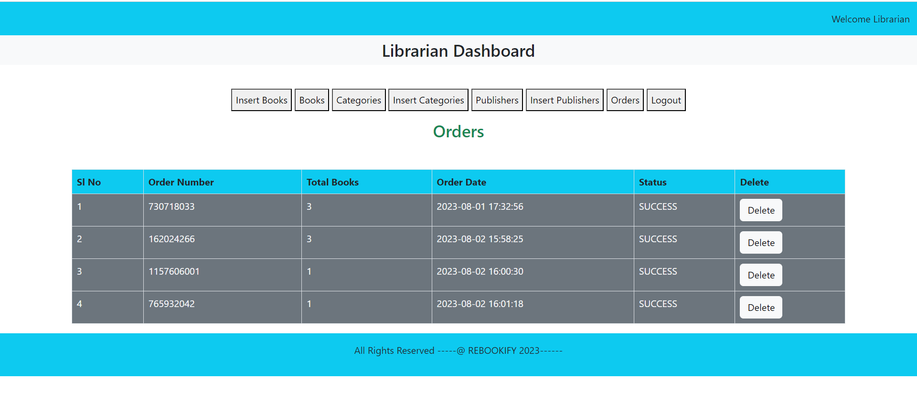

Slide 47
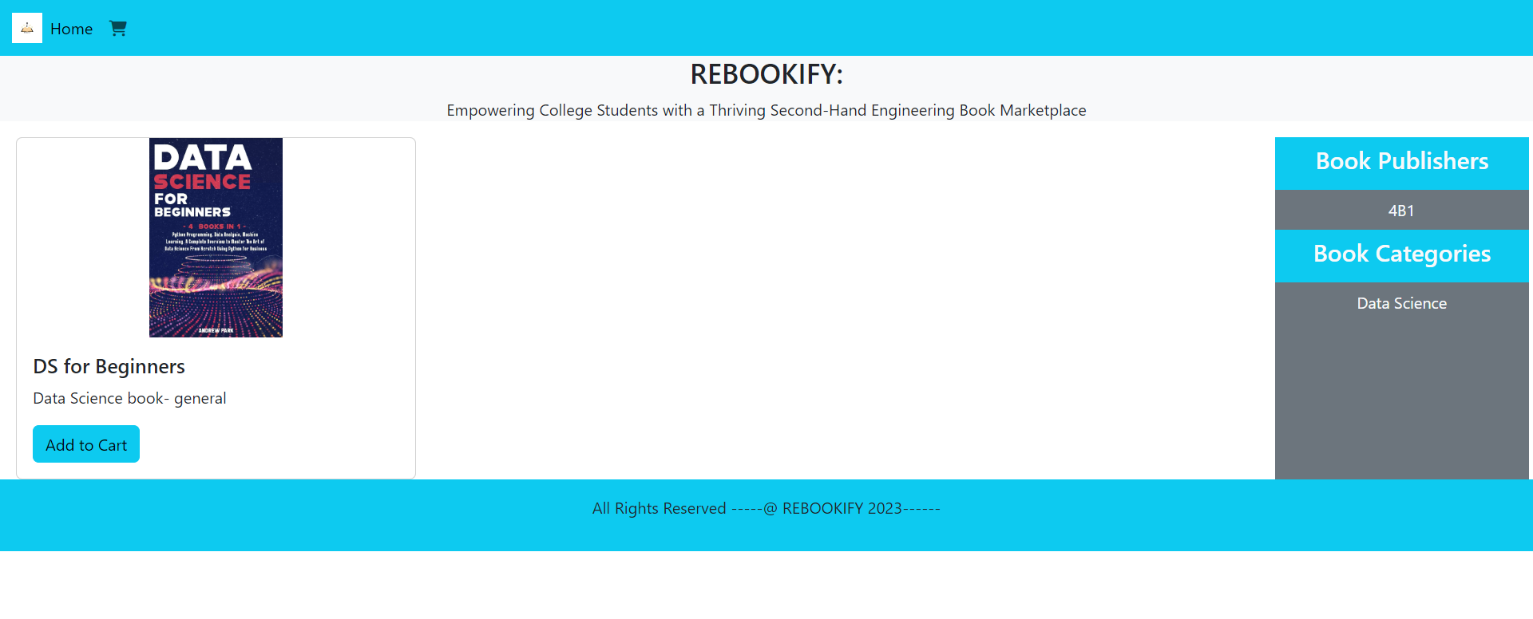

Slide 48
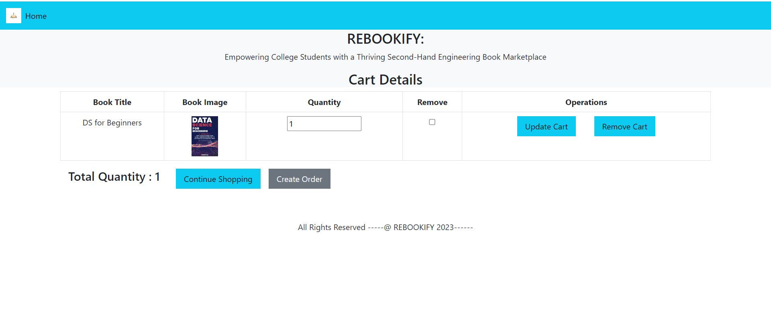

Slide 49
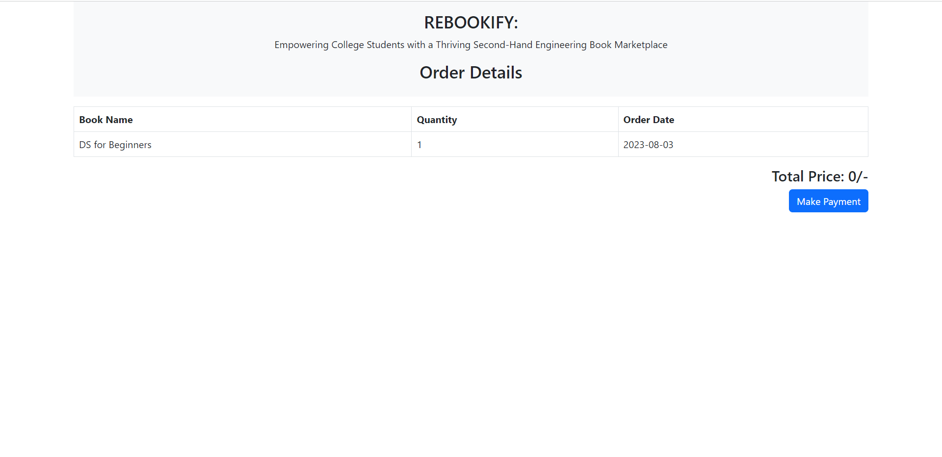

Slide 50
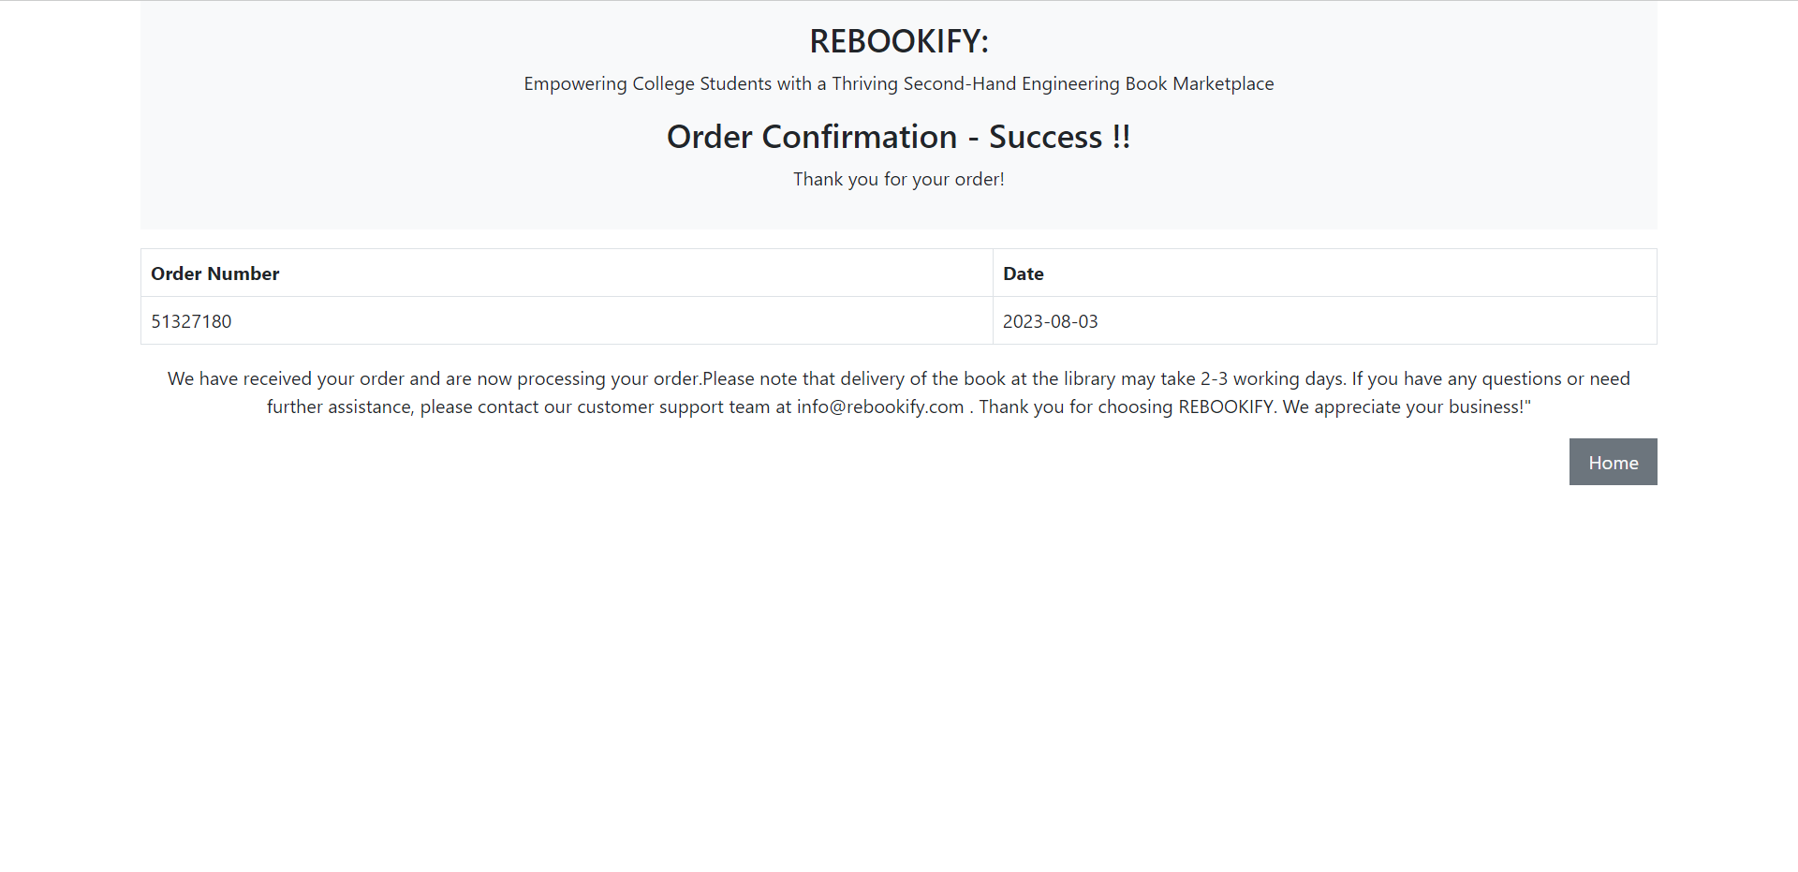

Slide 51

THANK YOU
Team Members:
Christom Joseph
Geo Mathew Gregory
Salviyas Sojan
Project Guide:
Dr. Priya Mariam Raju
Project Coordinator:
Ms. Taniya Shirley Stalin

